Slide 1

Heart disease prediction using machine learning
Streamline Operations, Maximize Productivity
Your Company Name

Slide 2
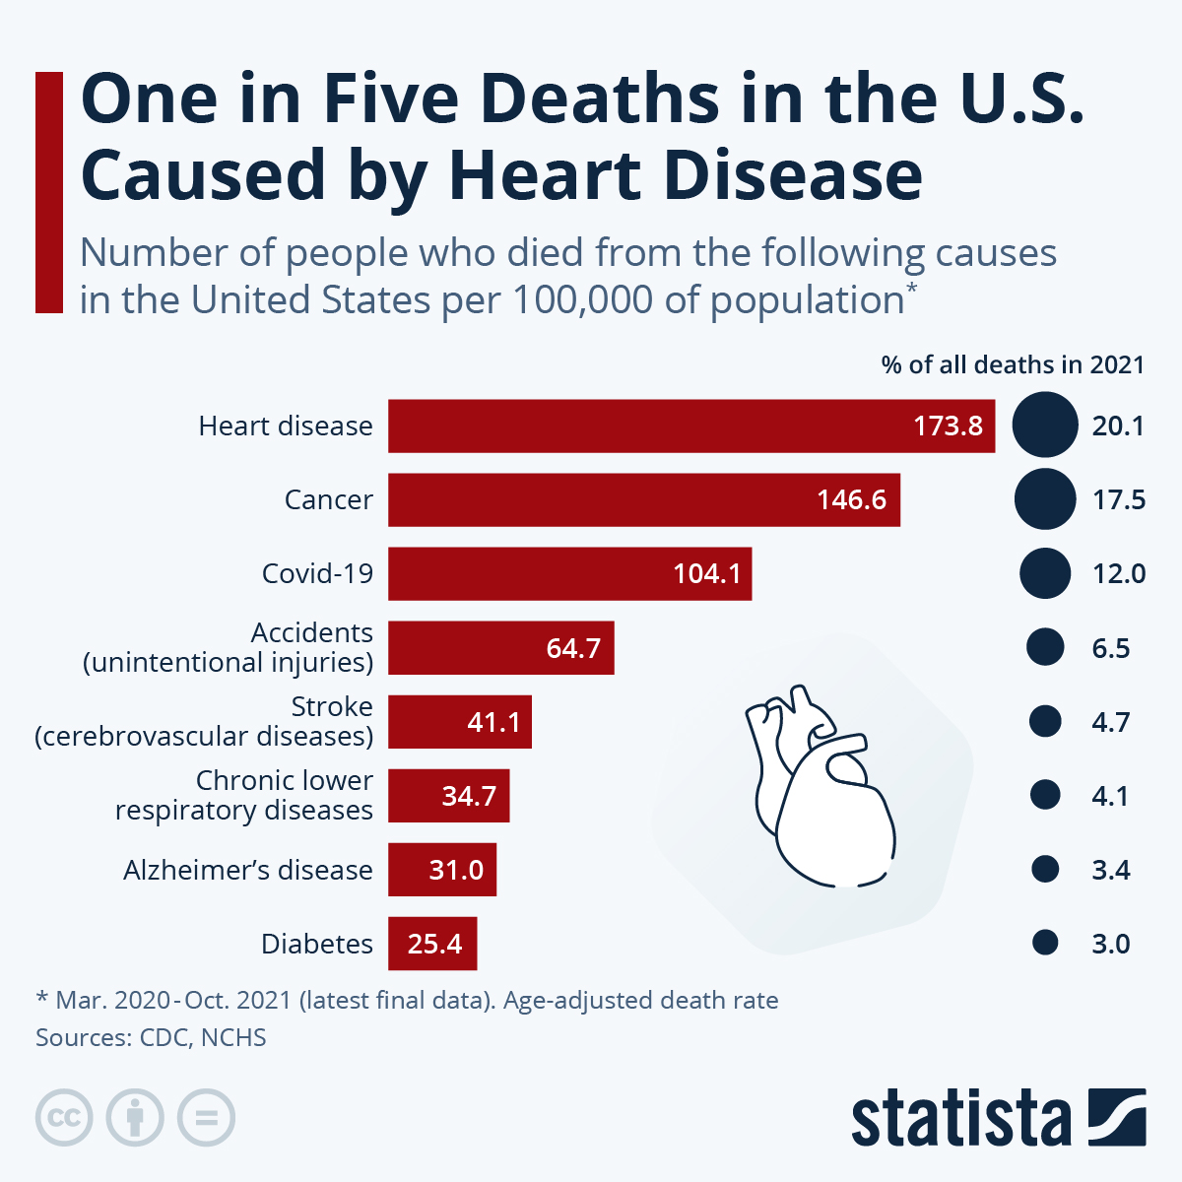
The Challenge Businesses Face Today
- Heart disease often goes undiagnosed especially in early stages
-predictive models struggle due to imbalanced data
- This imbalance creates imbalanced models
- Time is wasted

Slide 3
Introducing heart disease prediction
Our heart disease prediction model is designed to streamline your business operations.
Integrate all aspects of project management, collaboration, and reporting into one platform.
Ease of use combined with powerful features tailored for businesses of all sizes.

Slide 4

What Sets Us Apart
-Multi-Model Approach for Robustness:
Instead of relying on a single machine learning model, our project uses a combination of four different models averaging their accuracies to make predictions.
- Focus on Class Imbalance Solutions:
we tackled the significant challenge of class imbalance, which is common in medical datasets but often overlooked. Our use of techniques like SMOTEN and undersampling ensures that the models are not biased toward predicting the majority class.
Accuracy and Scalability:
With an overall accuracy of 82.5%, your model demonstrates strong predictive power, but its ability to handle imbalanced data is what makes it especially valuable in real-world medical applications

Slide 5
Why Choose heart disease prediction
Data-Driven, AI-Powered Insights
Multiple Models for Better Accuracy
Addressing Class Imbalance – A Critical Challenge
- Scalable: Suitable for businesses of all sizes, from startups to enterprises. 24/7 Support: Dedicated customer support to ensure seamless operation.

Slide 6
Who Can Benefit?
- Small to Medium-Sized Businesses (SMBs)
- Enterprises
- Project Managers
- Freelancers
- Remote Teams

Slide 7
What Our Customers Say
- Customer Testimonial 1: Share a powerful quote or success story from a satisfied client.
- Customer Testimonial 2: Highlight measurable results (e.g., “Increased team productivity by 30%”).
- Case Study: Walk through a specific case where [Software Name] solved a major business problem.

Slide 8
Affordable Pricing Plans to Suit Every Business
- Basic Plan: Ideal for small teams
- Professional Plan: For growing businesses
- Enterprise Plan: For large organizations with advanced needs
Include features per plan, pricing details, and any free trial offers.

Slide 9
Ready to Transform Your Business?
Sign Up Today
Encourage immediate action with a free trial or demo.
Website: Direct them to your site for more information.
Contact Us: Include details for direct contact (email, phone number, etc.).

Slide 10
Thank You!
Thank you for your time and attention.
Reinforce the call to action (e.g., “Visit our website to get started today!”).
Company logo, website, and social media links.

